Slide 1
Heart Disease Diagnostic Project
Detailed project report

Slide 2
Project Details
Project Title | Heart Disease Diagnostic Analysis
Technologies | Data Science
Domain | Healthcare
Project Difficulties level | Intermediate
Programming language used | Python
Other tools used | Tableau, Jupyter Notebook

Slide 3
Problem Statement
Health is real wealth in the pandemic time we all realized the brute effects of covid-19 on all irrespective of any status . You are required to analyse this health and medical data for better future preparation.

Slide 4

ARCHITECTURE
Raw Data Collection
Importing Libraries in Python
Load Dataset
Data Pre-processing
Real world
Insights
Tableau
Data Modelling
Exploratory Data Analysis
Reporting

Slide 5
Dataset Information
The data extracts various information such as Heart Disease rates, Heart Disease by gender , by age.
age: age of people in the population
sex: sex of person (1-Male , 0-Feamle)
cp: chest pain type ( 0-typical angina,1-atypical angina,2-non_anginal pain,3-asymptomatic)
trestbps: resting blood pressure
chol:serum cholesterol in mg/dl
fbs: fasting blood sugar > 120 mg/dl (1-True , 0-False)
restecg: resting electrocardiographic results (values 0-normal, 1-having ST-T wave abnormality,2-probable or definite left ventricular hypertrophy by Estes' criteria)
thalach: maximum heart rate achieved
exang: exercise induced angina (1-Presence, 0-Absence)
oldpeak: ST depression induced by exercise relative to rest
slope: the slope of the peak exercise ST segment (0-downslopping, 1-flat, 2-upslopping)
ca: number of major vessels (0-3) coloured by fluoroscopy
thal:1 - normal, 2- fixed defect , 3 - reversible defect, 0- Null
target: Heart disease ( 0-No , 1-Yes)

Slide 6
Importance of each attributes
Age: Age is a crucial factor in heart disease as it serves as a well-established risk indicator, reflecting the natural changes in the cardiovascular system with aging. Additionally, age contributes to data stratification, helping identify age-specific patterns and interactions with other risk factors, enhancing the diagnostic accuracy and relevance.
Sex:The inclusion of gender as an attribute is relevant due to the differences in the prevalence, symptoms, and risk factors between men and women.
Resting Blood Pressure: Elevated resting blood pressure is a key risk factor for heart disease. It strains the heart, contributes to artery damage, and increases the likelihood of atherosclerosis. Monitoring and managing blood pressure through lifestyle changes and, if necessary, medication are crucial for cardiovascular health.
Cholesterol: Elevated levels of low-density lipoprotein (LDL) cholesterol contribute to the formation of arterial plaque, leading to atherosclerosis and an increased risk of heart disease. Managing cholesterol through lifestyle changes or medication is crucial for preventing and mitigating these cardiovascular risks.
Old Peak: ST depression on an ECG is a significant finding that suggests myocardial ischemia or other cardiac abnormalities, particularly in the context of suspected or known heart disease. It serves as an important diagnostic indicator, aiding clinicians in the assessment and management of patients with cardiovascular conditions.

Slide 7
Fasting Blood Sugar: Fasting blood sugar is an important attribute in heart disease datasets because it provides insights into an individual's metabolic health, diabetes status, and cardiovascular risk, thereby informing risk assessment, early detection, treatment strategies, and research efforts related to heart disease prevention and management.
Thalach: "Thalach" refers to the maximum heart rate achieved during an exercise test (often measured in beats per minute) . It provides valuable information about cardiovascular fitness, helps diagnose cardiac conditions, assesses risk, guides exercise prescription, evaluates treatment outcomes, and contributes to scientific research in the field of cardiology.
Exang: Exercise-induced angina, also known as exertional angina or angina pectoris, is chest pain or discomfort that occurs during physical activity or exertion. Exercise-induced angina plays a crucial role in heart disease datasets by serving as a diagnostic marker, assessing disease severity, stratifying risk, guiding treatment decisions, predicting prognosis, and supporting research efforts in the field of cardiology.

Slide 8
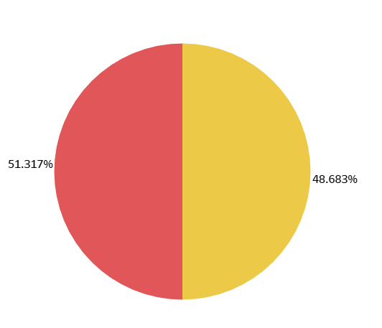
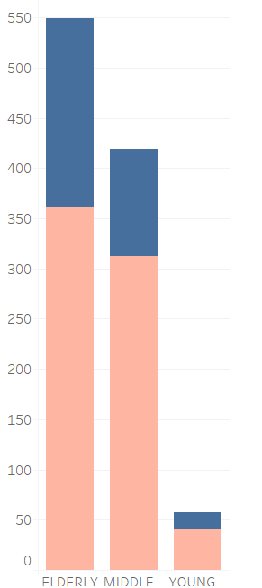


INSIGHTS
Affected Population
Population Distribution
51.31% of the population has heart disease.
Among the population elderly people(>55) is more.
More men and women are from elderly age category .

Slide 9
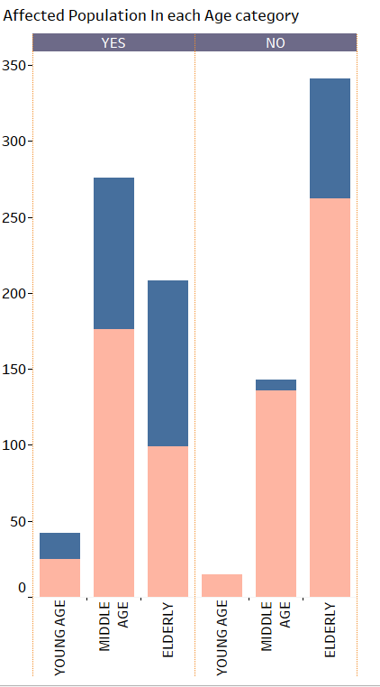
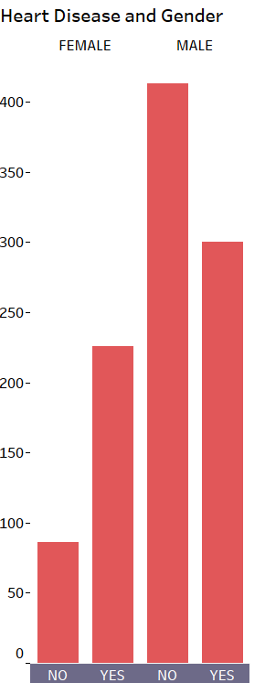
Who Suffers from Heart Disease
Middle Age people(Age between 40 and 55) are more prone to heart disease.
Heart Disease is seen more in male population than in female population.

Slide 10
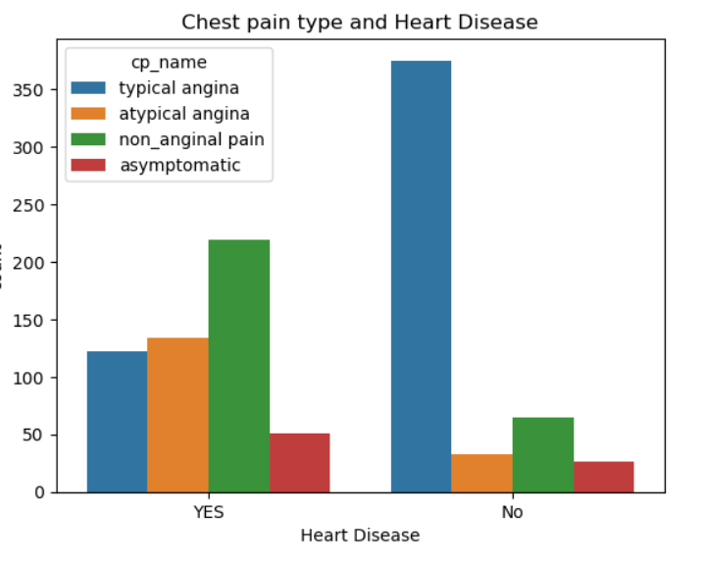
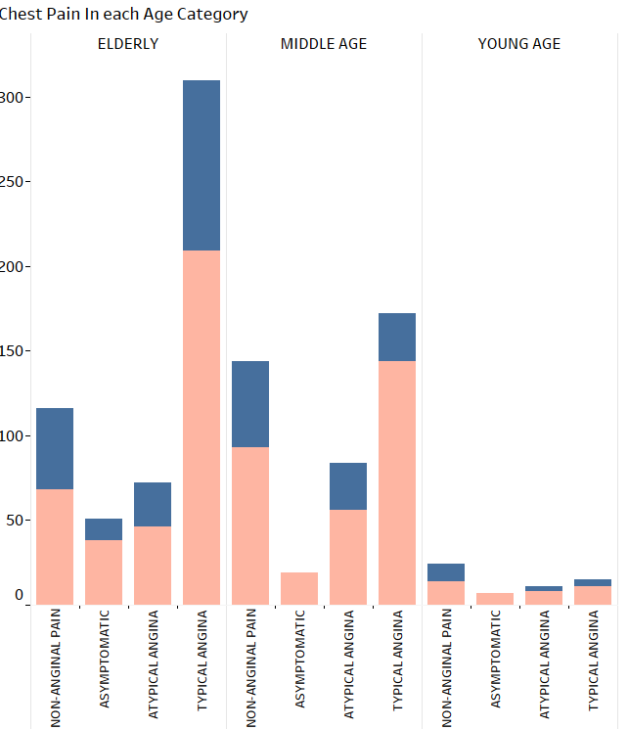
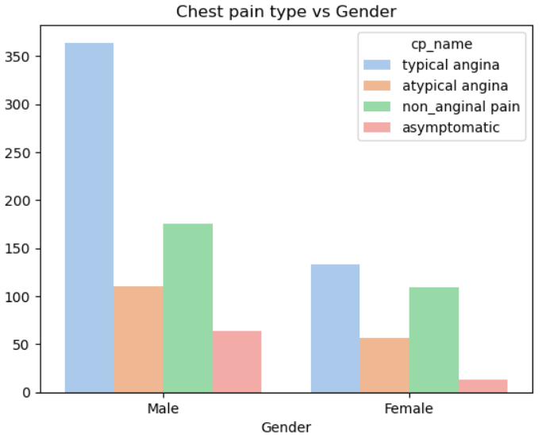
Heart Disease and Chest Pain
Non anginal pain is mostly seen in population prone to heart disease.
Population in the middle age group suffer more from non anginal pain
Non anginal pain is seen more in males than in females

Slide 11
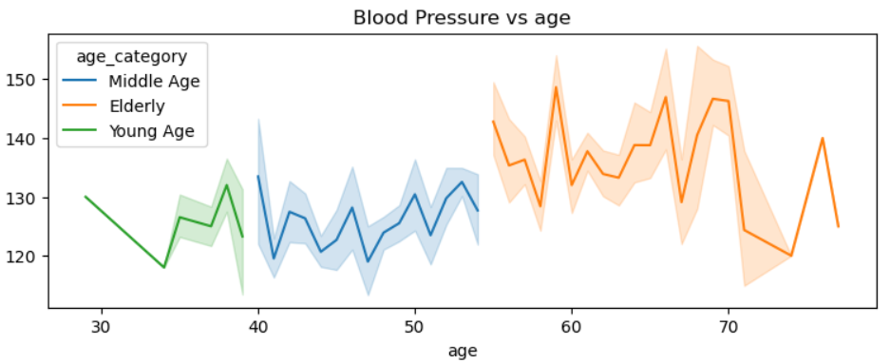
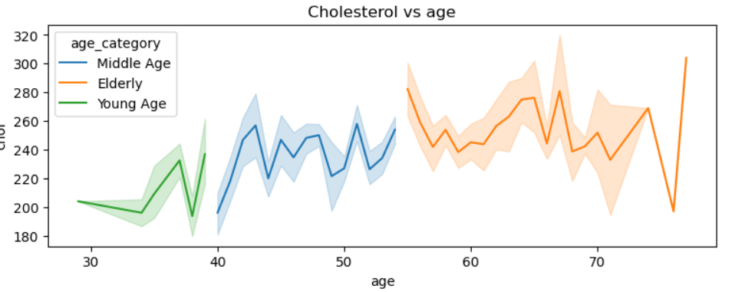
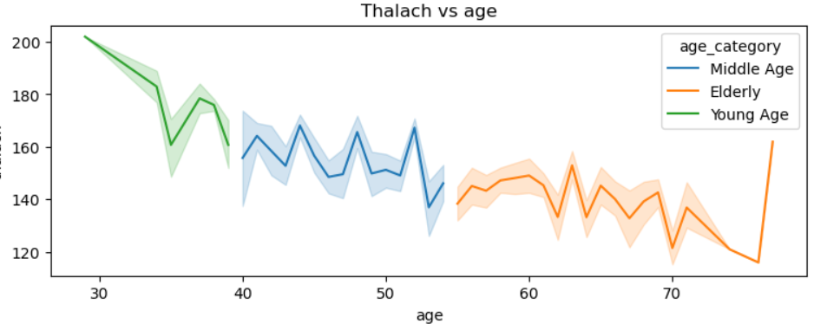
Other Factors
Blood Pressure increases after 55
Cholesterol is also seen to increase
after 55
Thalach(Max heart rate) decreases
as the age increases

Slide 12
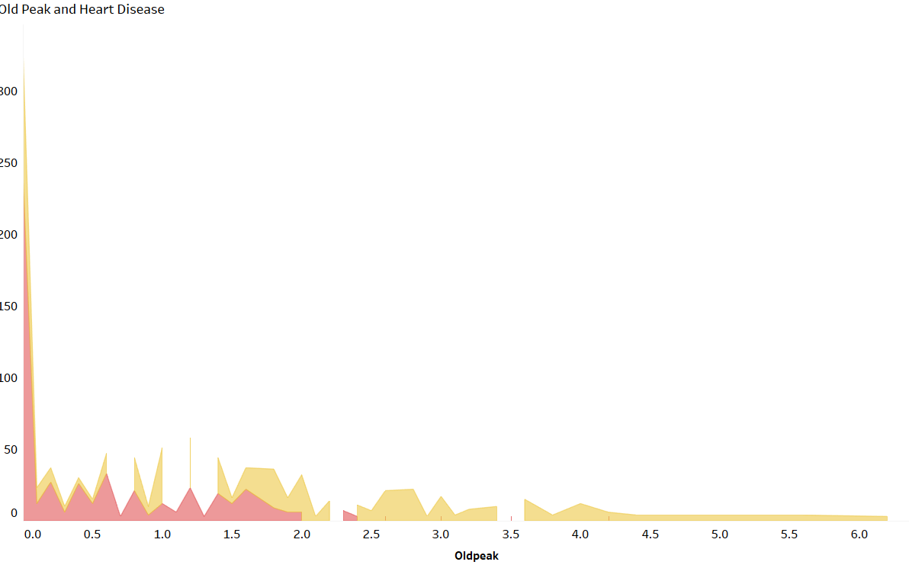
Old peak (ST Depression) value ranges between 0.0-2.0 for those prone to heart disease

Slide 13
KEY PERFORMANCE INDICATOR
Percentage of People Having Heart Disease
Age Distribution including Gender
Gender Distribution Based on Heart Disease
Chest Pain Experienced by People Suffering from Heart Disease
Blood Pressure, Cholesterol Level and Maximum Heart Rate of People According to their Age and Heart Disease Patients.
ST Depression Experienced by People according to heart disease patients.

Slide 14
CONCLUSION
51.31% of the population has heart disease.
Among the population elderly people(>55) is more.
More men and women are from elderly age category
Middle Age people(Age between 40 and 55) are more prone to heart disease.
Heart Disease is seen more in male population than in female population.
Non anginal pain is mostly seen in population prone to heart disease.
Population in the middle age group suffer more from non anginal pain
Non anginal pain is seen more in males than in females
Blood Pressure increases after 55
Cholesterol is also seen to increase after 55
Thalach(Max heart rate) decreases as the age increases
A high cholesterol can cause heart disease . Average cholesterol level is more in female
than in male.
Old peak (ST Depression) value ranges between 0.0-2.0 for those prone to heart disease

Slide 15
THANK YOU
END

